Slide 1
Car Price prediction project
By Rohit kattewar

Slide 2
OUTLINE
Case Study Description
Problem Statement
Data Processing
Data Visualization
Model Building
Final Model
Conclusion

Slide 3
Case Study Description
With the Covid-19 impact in the market, we have seen lot of changes in the car market. Now some cars are in demand hence making them costly and some are not in demand hence cheaper.
One of our clients works with small traders, who sell used cars. With the change in market due to Covid-19 impact, our client is facing problems with their previous car price valuation machine learning models. So, they are looking for new machine learning models from new data. We have to make car price valuation model.
In the dataset, I have scrapped 6000 different kinds used cars data. The source of this data is www.olx.in.
The given dataset contains various Brands, Models, Kilometers driven, Manufacturing Year, Number of Owners, Fuel Type of the particular car, and finally the price of the car. These cars are selling in various locations in India. The given dataset includes all types of cars for example- SUV, Sedans, Coupe, etc.

Slide 4

Problem Statement
Our clients works with small traders, who sell used cars. With the change in market due to Covid-19 impact, our client is facing problems with their previous car price valuation machine learning models. So, they are looking for new machine learning models from new data. We have to make car price valuation model.

Slide 5
Data Processing
Null Values : The dataset has no null values present in it originally.
Unique values and Value count of each column.
The “Kilometeres Driven” column has commas in the data so I removed the commas.
The “No of Owners” column has repetitive entries under 1st owner and First owner as well as 2nd and Second owner. So, I merged these data to 1st and 2nd owner respectively.

Slide 6
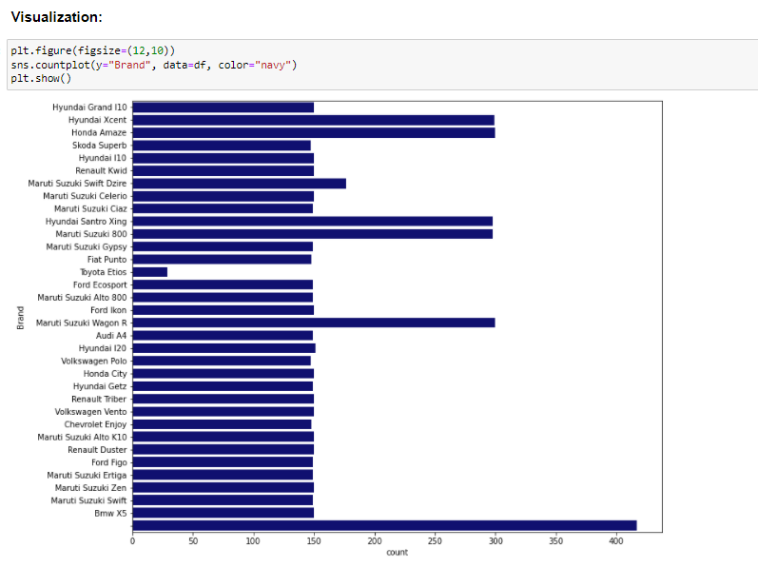
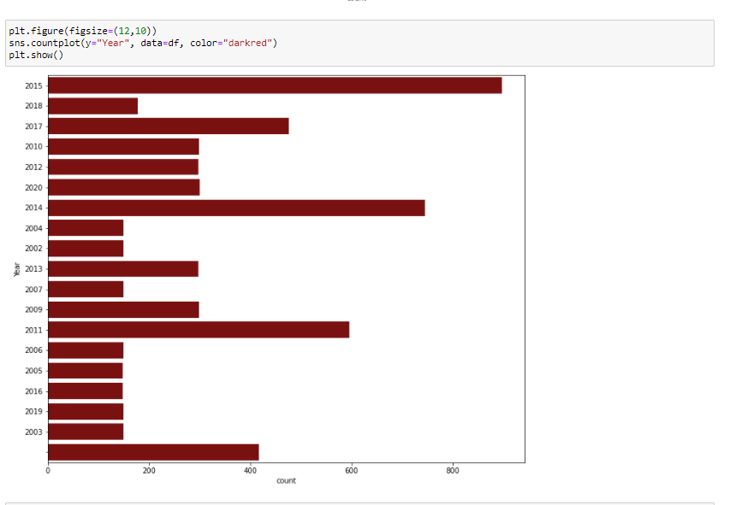
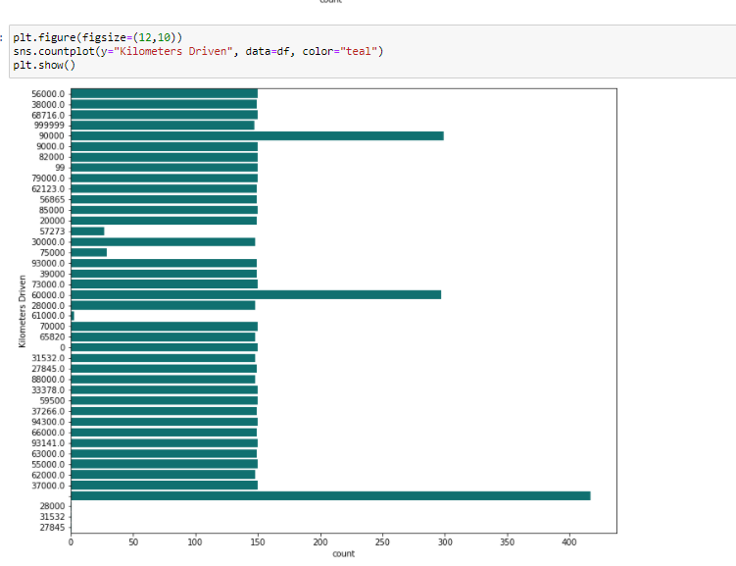
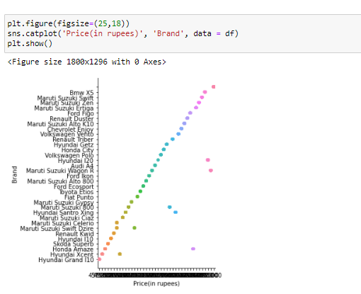
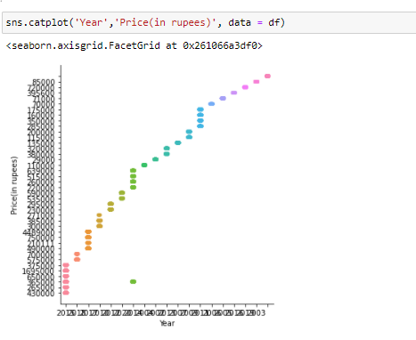
Data visualization

Slide 7
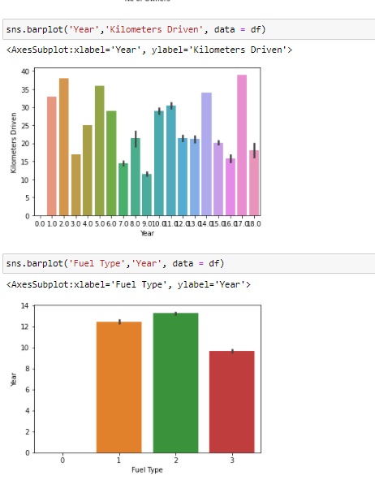
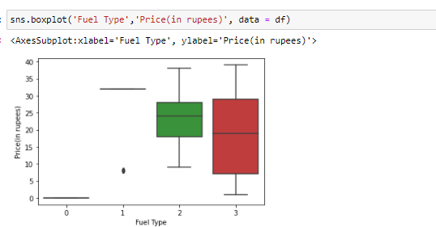
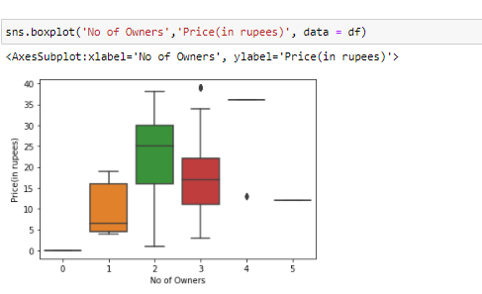
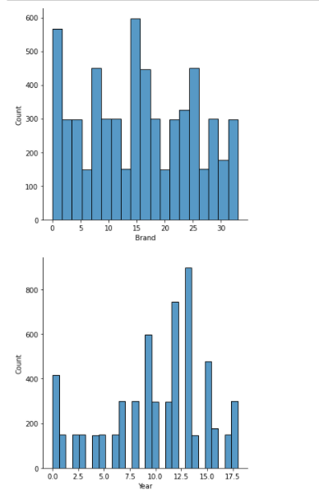
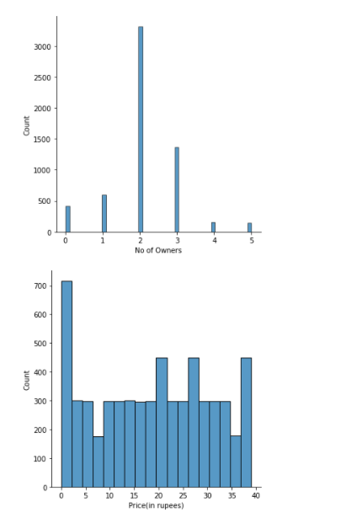
Data visualization

Slide 8
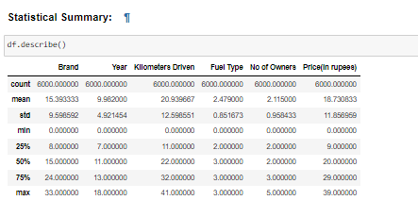
Statistical Summary

Slide 9
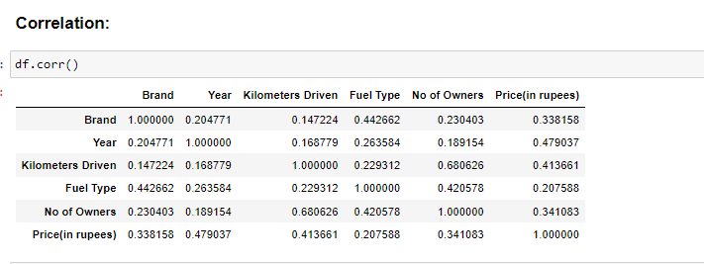
Correlation

Slide 10
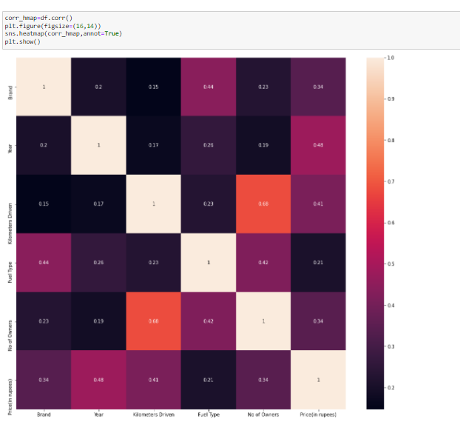
Correlation using Heatmap

Slide 11
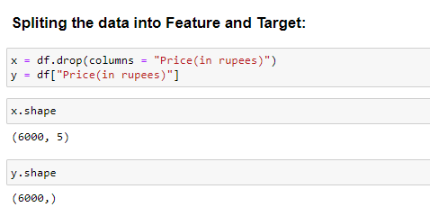
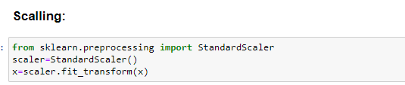
Model Building

Slide 12
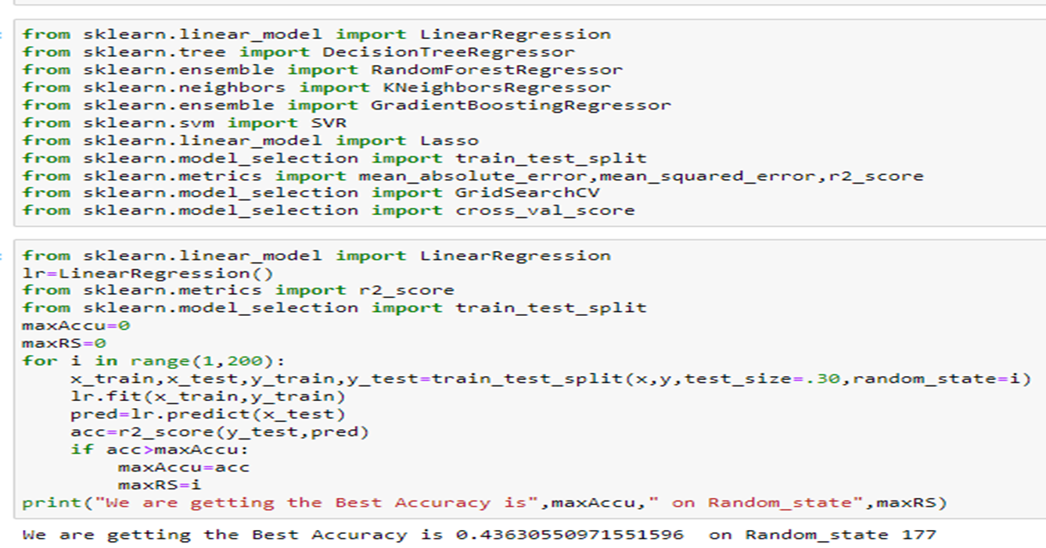
Getting the best accuracy score and random state

Slide 13
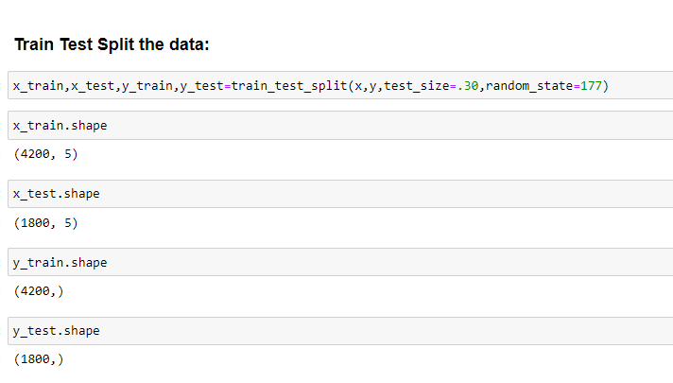
In order to build the model, we will be splitting the train, test and split the data and then train using following models.

Slide 14
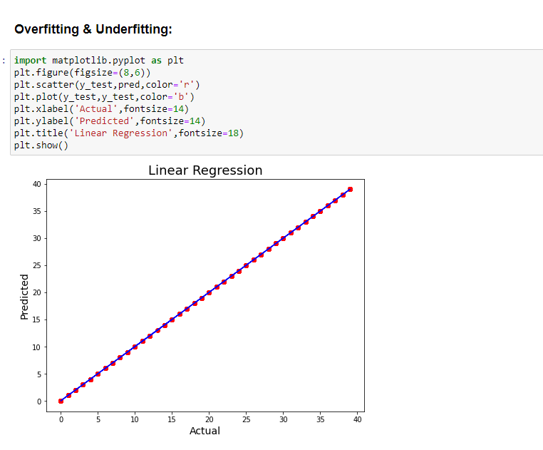

Slide 15
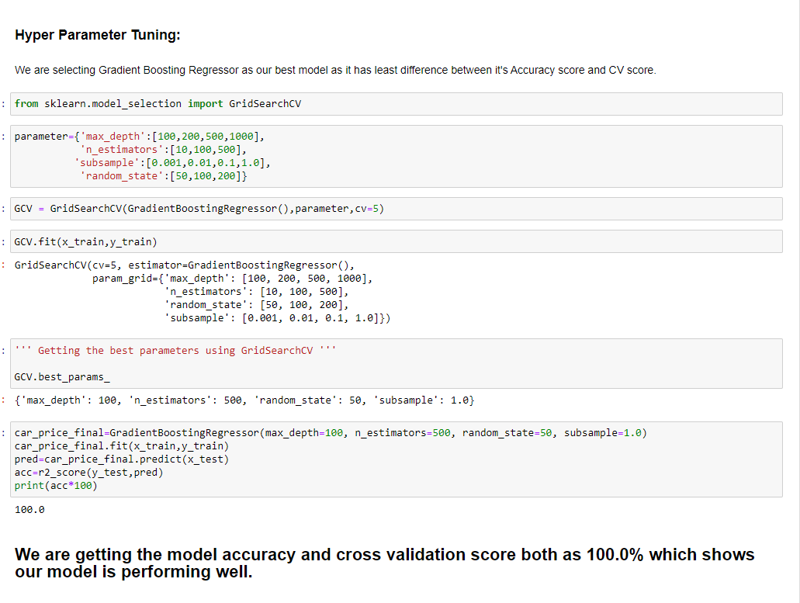
Model Performance

Slide 16
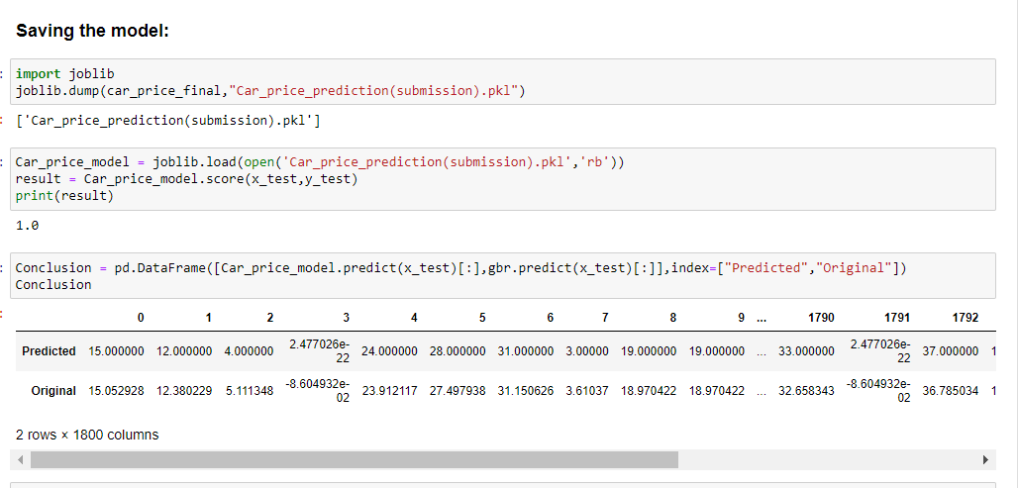
Conclusion

Slide 17
thank you

